Slide 1



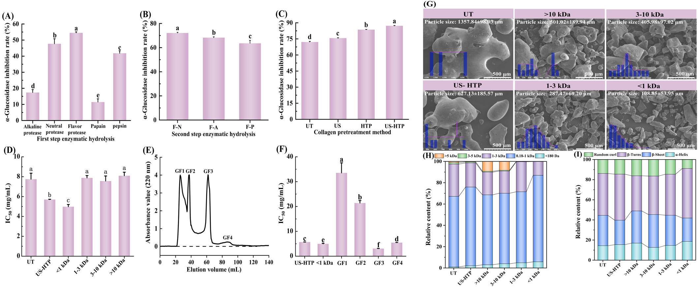
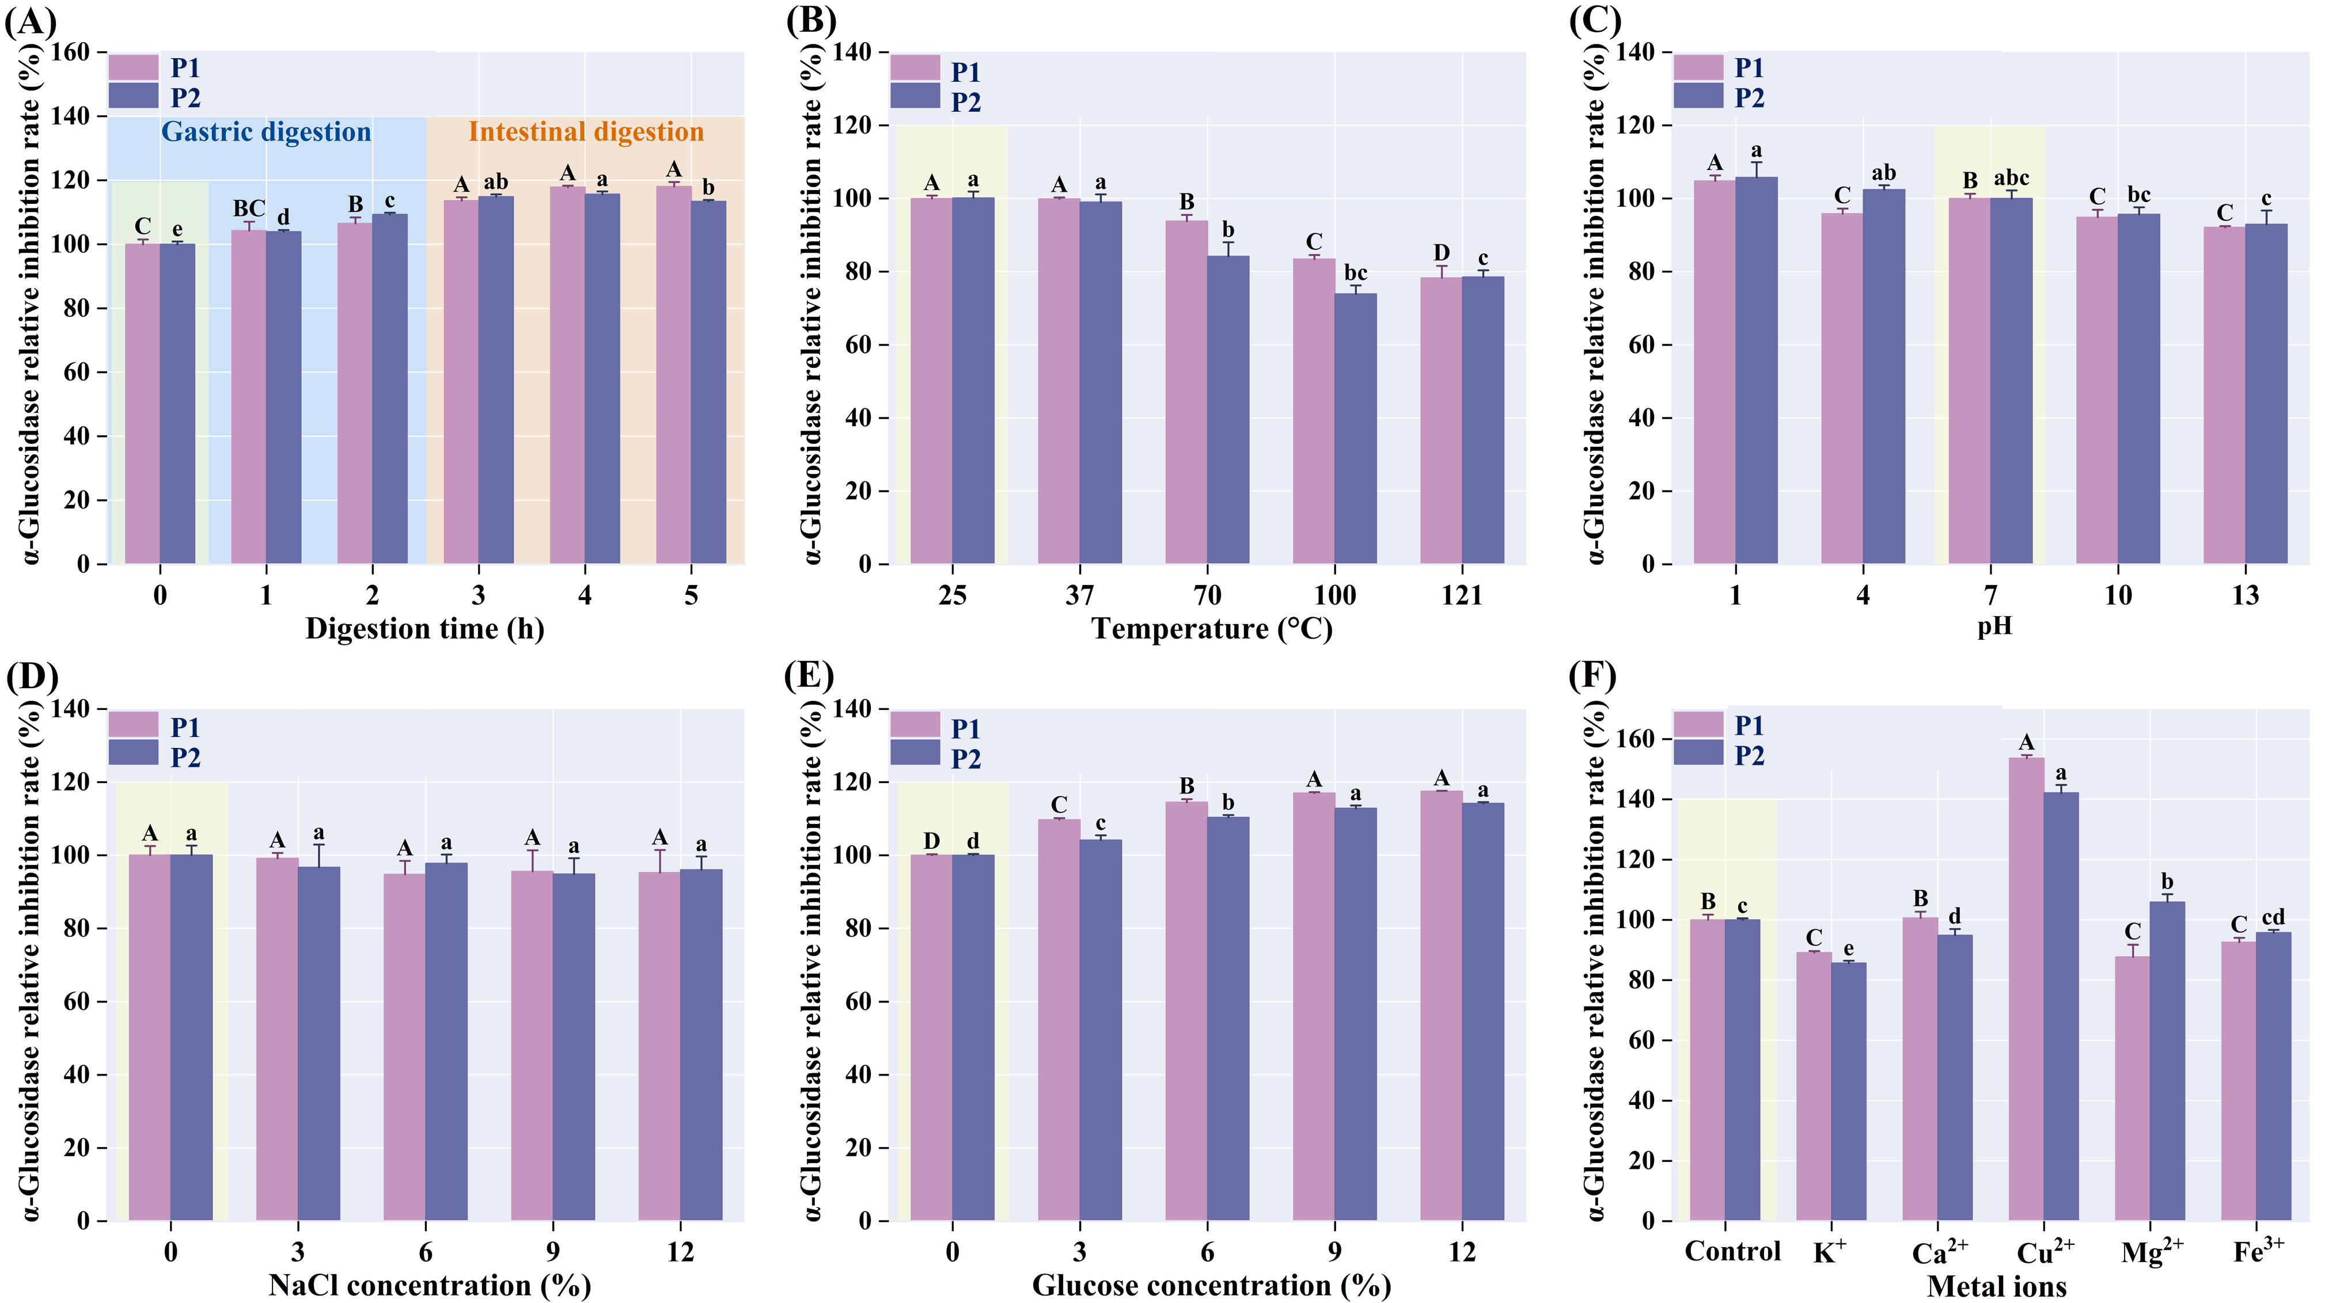
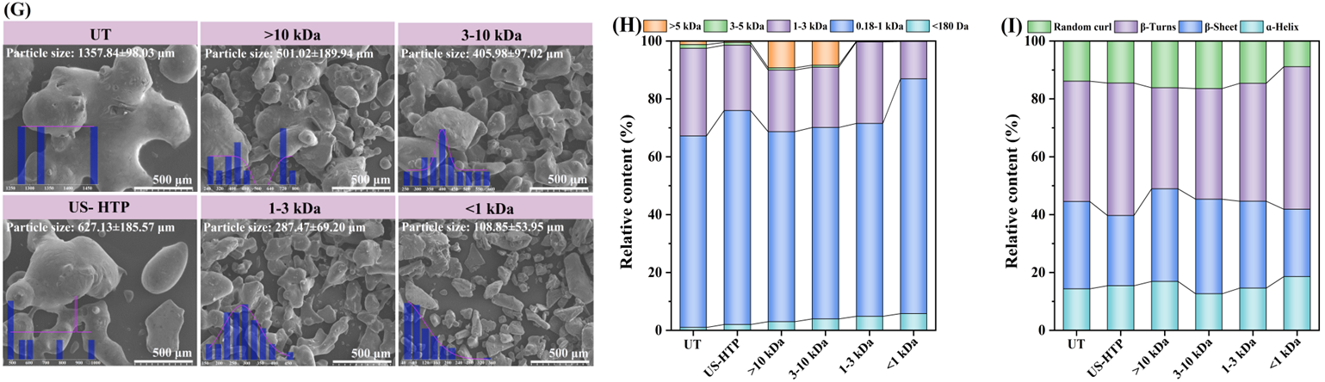
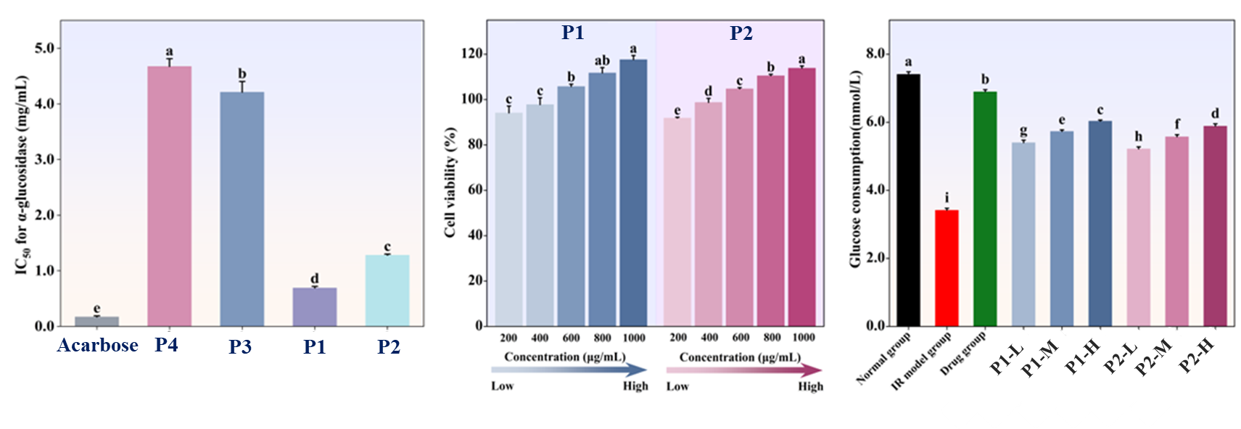
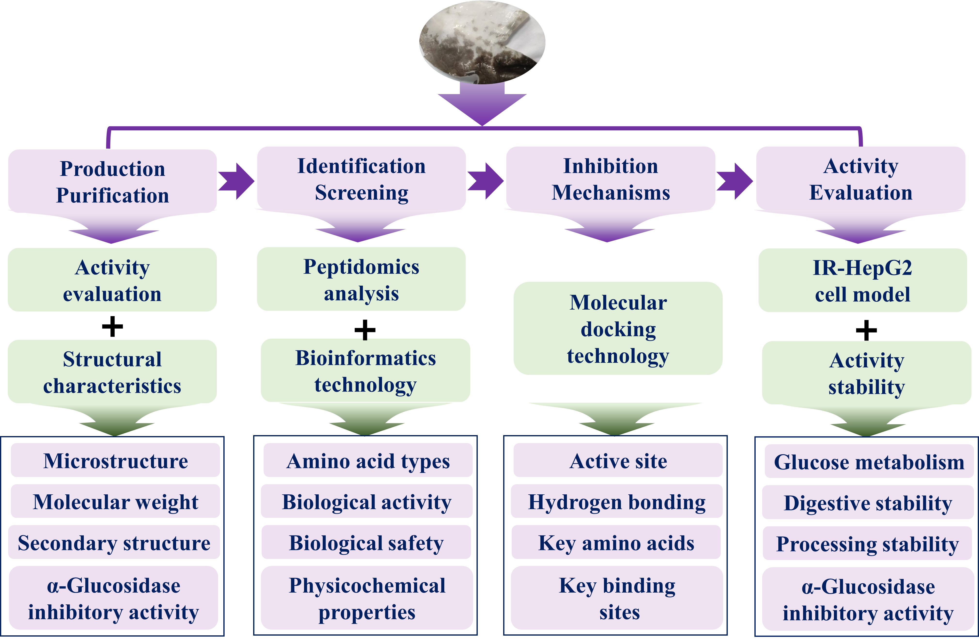
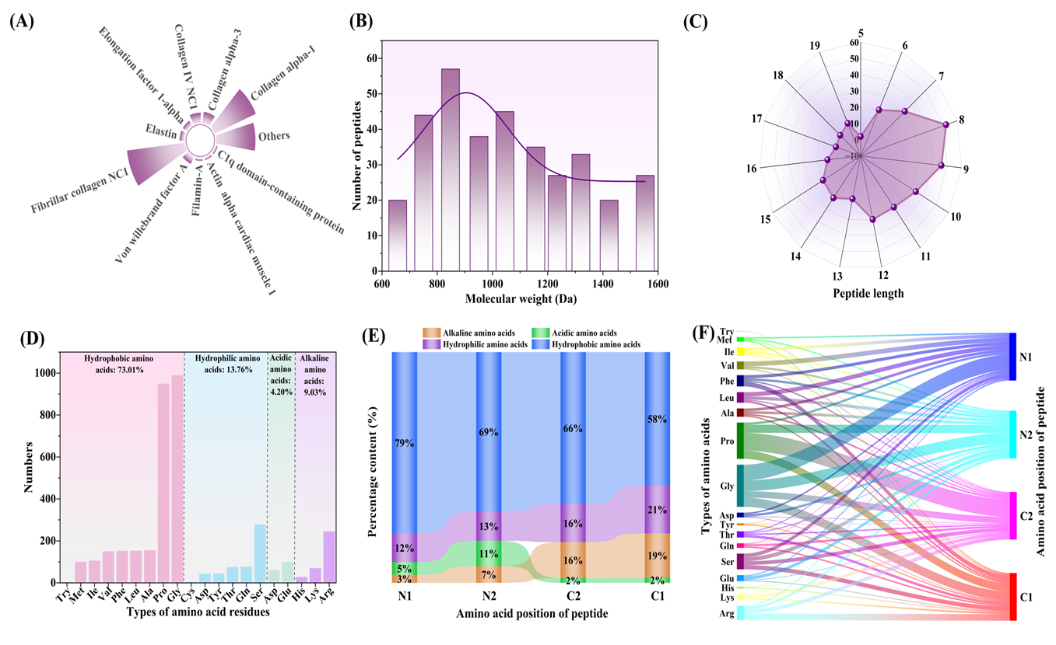
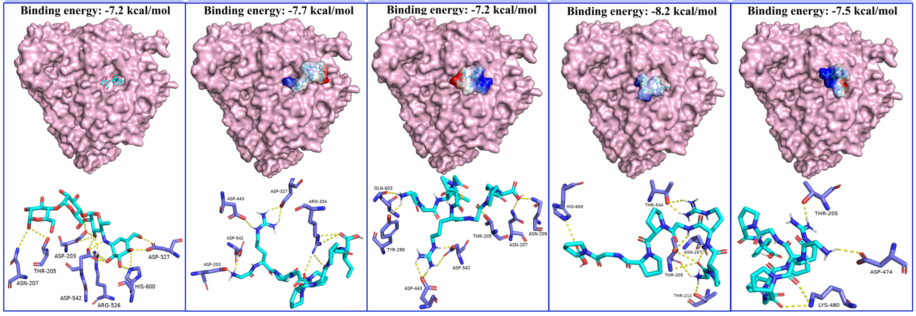
FSMILE 2025
Novel α-glucosidase inhibitory peptides derived from bullfrog skin: Preparation, screening, molecular mechanism of action, and activity evaluation
October 04-07, 2025
@Morioka & ZOOM Cloud
Xiaoshan Zheng ^{1, 2 , 3}, Ying Lu ^{1, 2, 3*}
1, College of Food Science and Technology, Shanghai Ocean University, Shanghai 201306, China
2, Shanghai Engineering Research Center of Aquatic-Product Processing and Preservation, Shanghai 201306, China
3, National R&D Branch Center for Freshwater Aquatic Products Processing Technology (Shanghai), Shanghai 201306, China
International Symposium on Food Communications and Sustainable Agri-Aqua Food Systems Connecting Primary Industries, Academia, and Society through the SDGs
Contact Information:
*Corresponding author: y-lu@shou.edu.cn
Introduction
Inhibiting α-glucosidase activity is a key target for improving T2DM, but traditional clinical drugs have side effects.
Collagen-rich bullfrog skin (BSC) is a high-quality source for preparing safe and effective α-glucosidase inhibitory peptides (BS-GIP).
The stable structure of collagen hinders the production of small molecular peptides. Ultrasonic-high temperature and high pressure (US-HTP) pretreatment may be a favorable option for enhancing the efficiency of collagen enzymatic hydrolysis.
Results
Conclusions
The US-HTP pretreatment combined with dual-enzyme stepwise hydrolysis significantly enhanced the α-glucosidase inhibitory activity of the BSC hydrolysate by 32.73%.
Gly1, Arg2, and Arg6 are the key amino acid residues in BS-GIP that form hydrogen bonds with the critical active sites (Thr205, Asp203, Asp327, Asp443, and Asp542) of α-glucosidase.
BS-GIP significantly inhibited α-glucosidase activity (IC₅₀=0.82±0.04 mM) and promoted glucose consumption by 76.83% in IR-HepG2 cells.
BS-GIP was exhibited excellent stability in gastrointestinal digestion and food processing.
Preparation of peptide fractions with high α-glucosidase inhibitory activity
High digestive stability and food processing stability
AIM
Preparation of highly active α-glucosidase inhibitory peptides through US-HTP pretreatment combined with stepwise hydrolysis using dual enzymes.
To elucidate the molecular mechanism by which BS-GIP inhibits α-glucosidase activity.
High inhibitory activity and glucose consumption
Method
Screening of α-glucosidase inhibitory peptides
Molecular mechanism of action for inhibiting α-glucosidase activity
P1
P2
P3
P4
References
Zhu M et al. Identification and characterization of novel α-glucosidase inhibitory peptides from sweet potato protein through heating combined with high hydrostatic pressure-assisted enzymatic hydrolysis. Food Chem. 2025; 145877.
Liu Z et al. Insights into novel α-glucosidase (α-GLU) inhibitory peptides from sturgeon fish muscle protein based on in-silico and in-vitro investigation. Food Well. 2025; 100010.
Wang D et al. Identification and molecular mechanism of novel bifunctional peptides from Duroc× (Landrace× Yorkshire) pig dry-cured ham: A peptidomics and in silico analysis. Food Rev Int. 2024; 180, 114066.
Acknowledgements
This work was supported by a grant from the National Natural Science Foundation general program of China (3217161149).

